Slide 1
Strengthening connections
New Zealand Country Report
13th APLAP Conference, 2021
Lily Phillips, Research Services Librarian
Daryl Slatter, Research Analyst
Nicole Cottrell, Research Services Manager

Slide 2
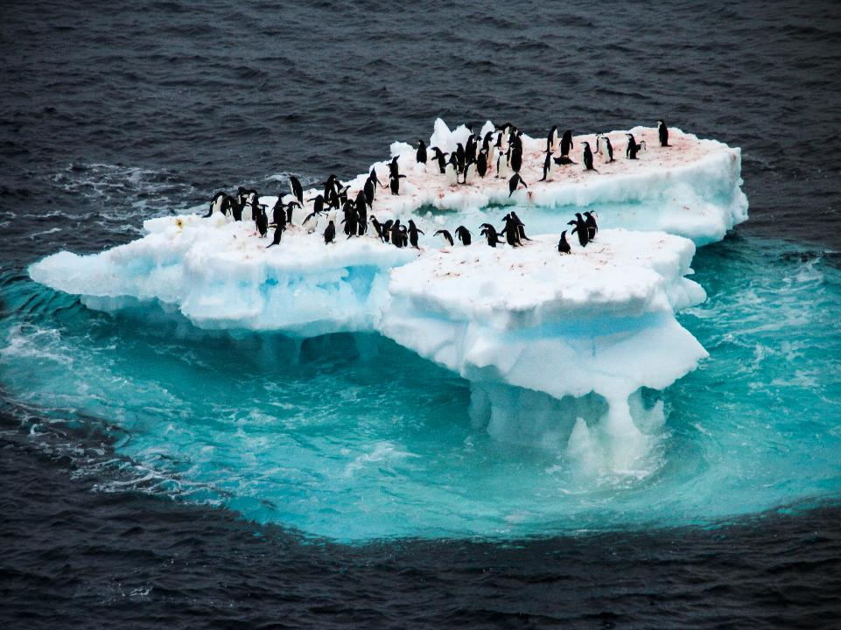
Notes:
John Kotter, Our iceberg is melting: changing and succeeding under any conditions

Slide 3
Electorate & Community Offices
Outreach activities

Slide 4
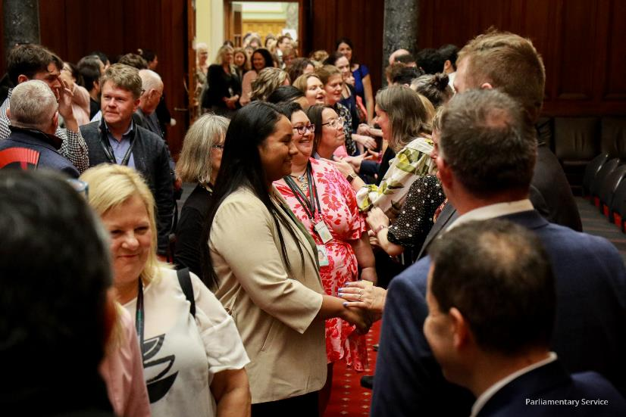
Electorate & Community Offices
First conference at Parliament – April/May 2021

Slide 5
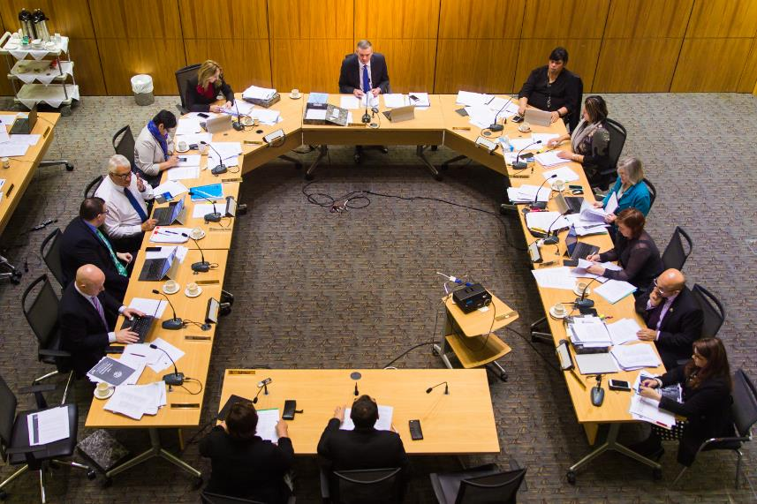
Supporting Select Committees

Slide 6
Library researchers as members of select committee secretariats

Slide 7
Linked-up services supporting policy development

Slide 8
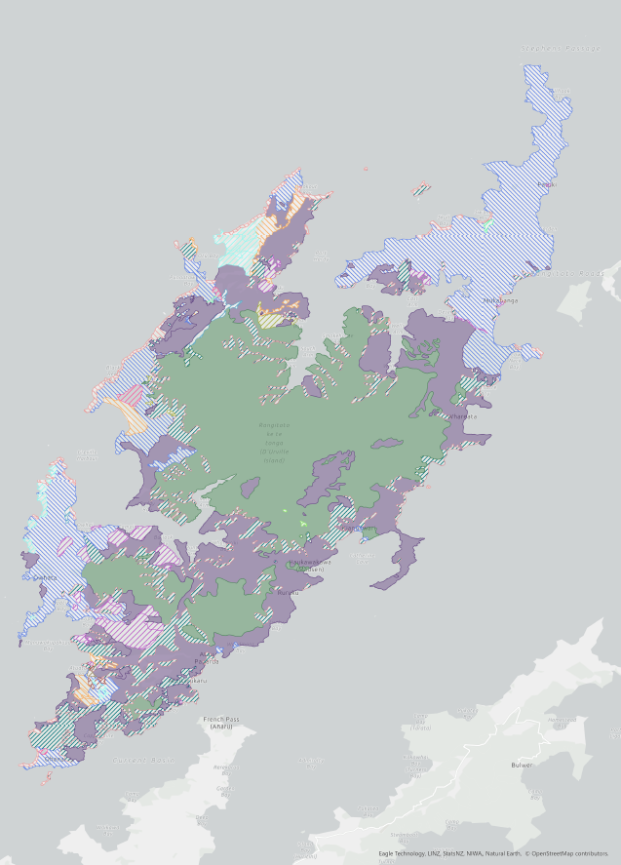
Research units
Policy scenario presentation

Slide 9
Costings
Helping clients make informed decisions

Slide 10
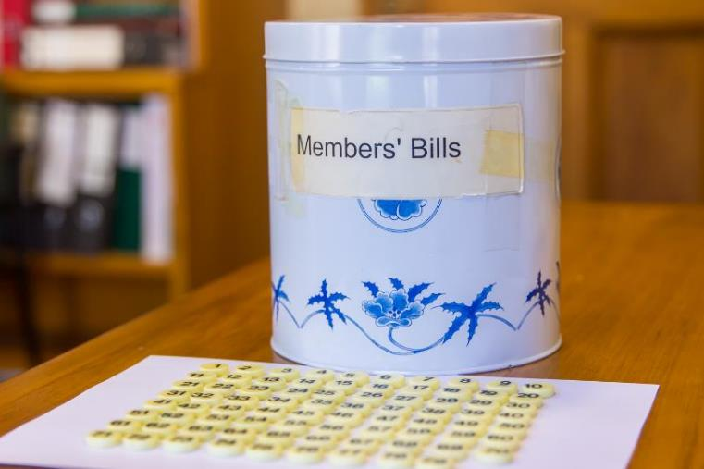
Members’ Bills
Research to assist with evidence-based policy

Slide 11
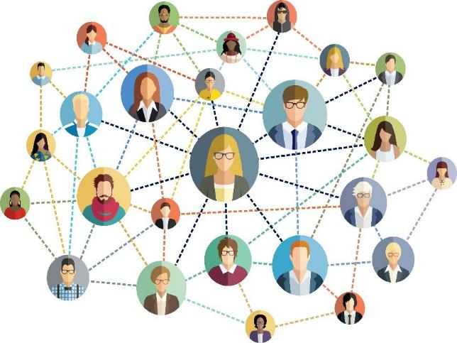
A new Parliamentary Librarian and structure
Notes:
Our Parliamentary Librarian

Slide 13
Thank you
Te Pātaka Rangahau /
New Zealand Parliamentary Library
Contact us: library@parliament.govt.nz

