Slide 1
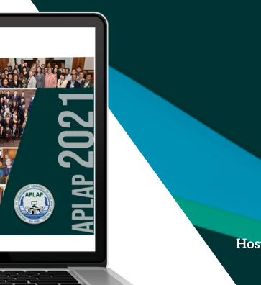
Disaster Preparedness, Response, and Recovery
in Parliamentary Libraries

Slide 2
Agenda
Definitions
Libraries & Disasters: Reality vs Fantasy
Risk Categories and Types
Disaster Preparedness
Risk Assessment & Grading Scale
Digital Preservation Planning
Recovery
Do’s & Don'ts

Slide 3
Risks
Risk is..
  An unavoidable reality for every organization. It can take many forms and can disrupt every facet of operations in the worst cases.
  The chance of something happening that will have an impact on objectives.
  Events with negative effect creating a value and diminishing the existing value.
  The probability for the hazard to turn into damage.
For Libraries, risk could be defined as the possibility that an event will occur and adversely affect the achievement of the library’s objectives.

Slide 4
Disaster
An event that results in great harm, damage, or death, or serious difficulty. (Cambridge English Dictionary)
A serious disruption of the functioning of a community or a society at any scale due to hazardous events interacting with conditions of exposure, vulnerability and capacity, leading to one or more of the following: human, material, economic and environmental losses and impacts. (UNDRR: United Nations Office for Disaster Risk Reduction)
A disaster, whether natural or man-made is “an event whose timing is unexpected and whose consequences are seriously destructive” (IFLA Disaster manual: Hilda Bohem, 1978).

Slide 5
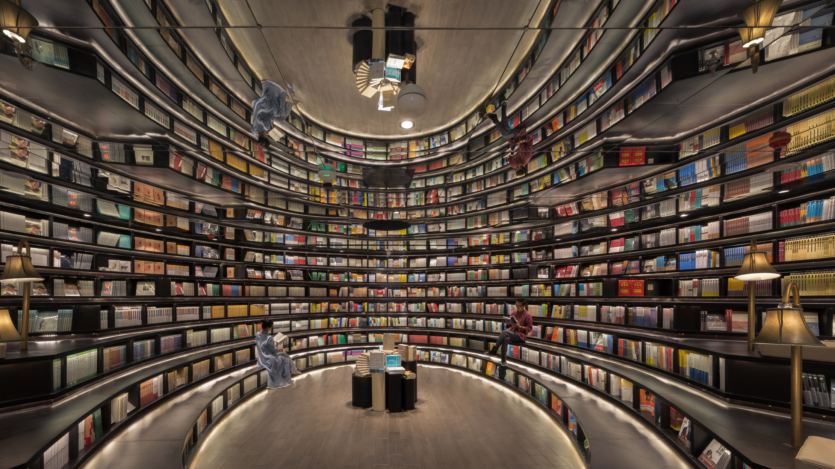
Libraries & Disasters
Fantasy becomes reality

Slide 6
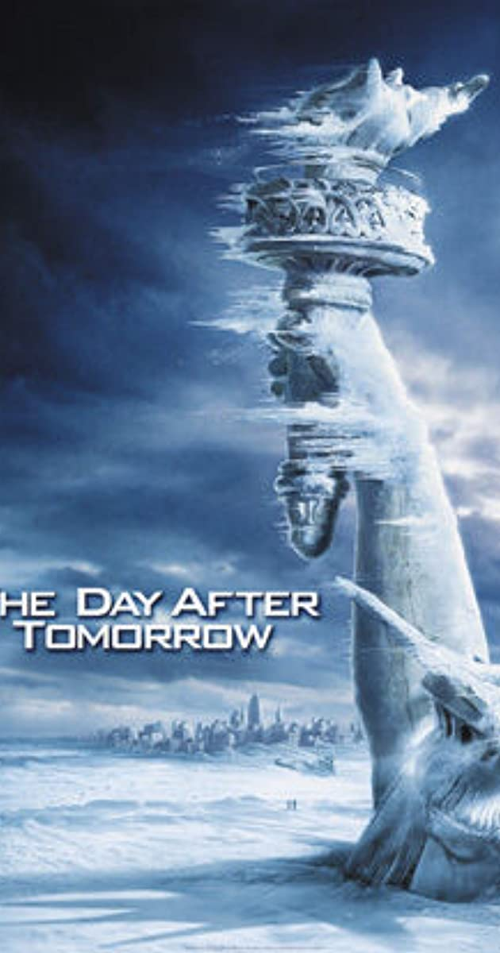
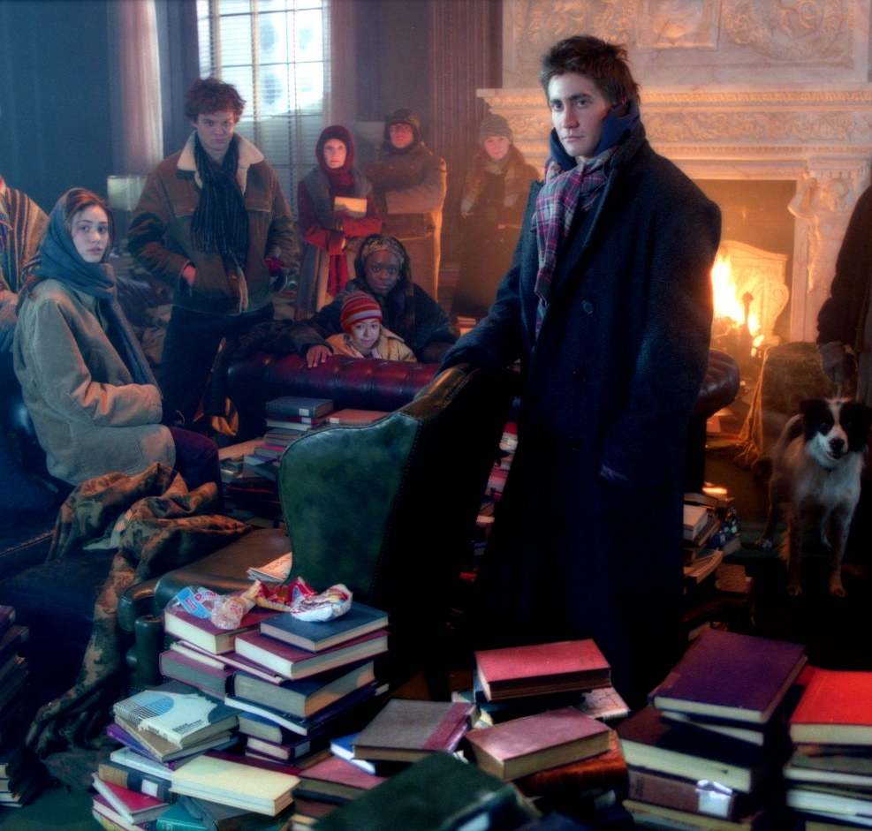
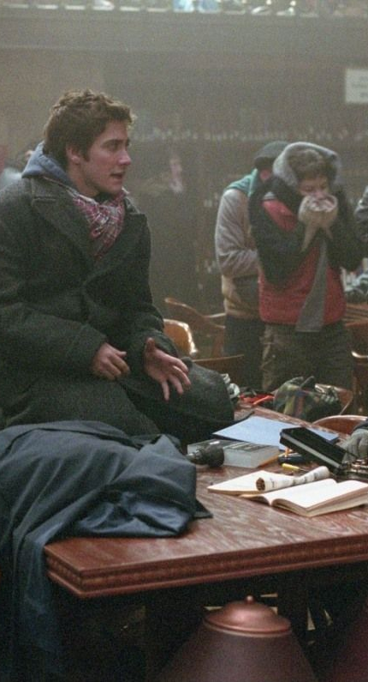
Notes:
The Day After Tomorrow (2004)

Slide 7
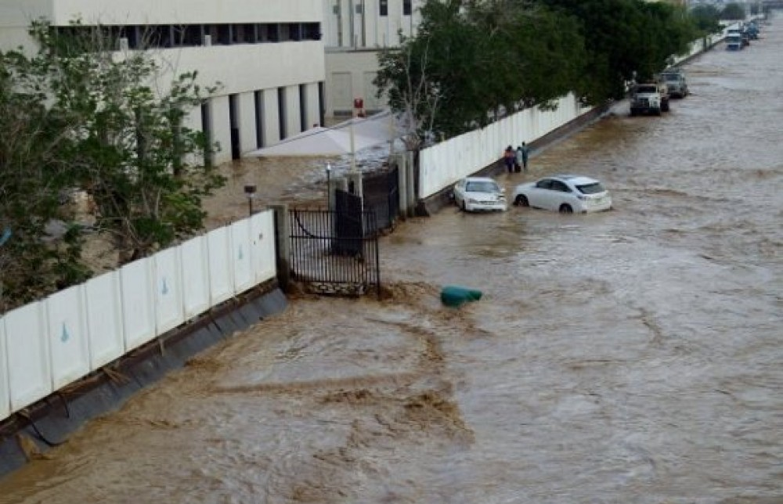
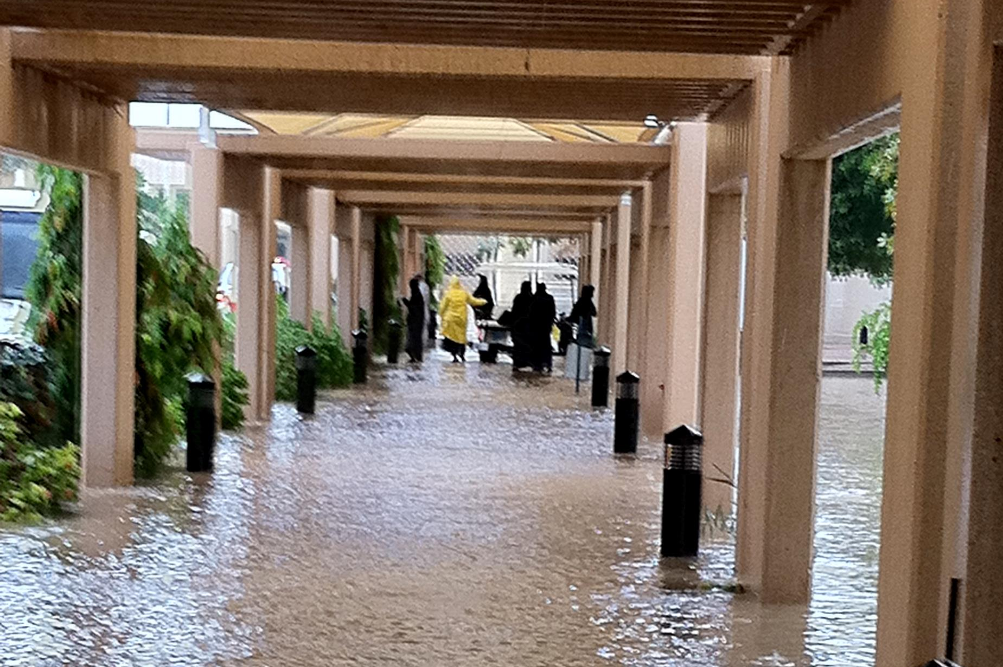
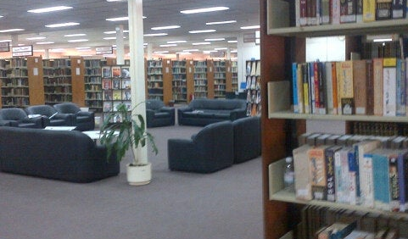

Notes:
King Abdualziz University

Slide 8
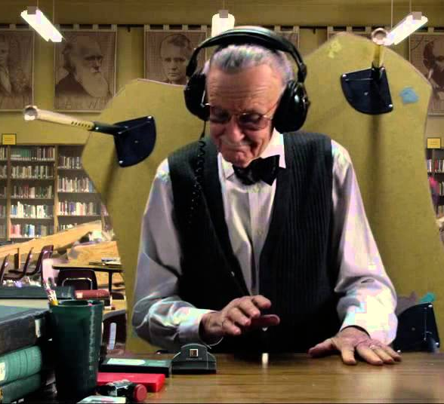
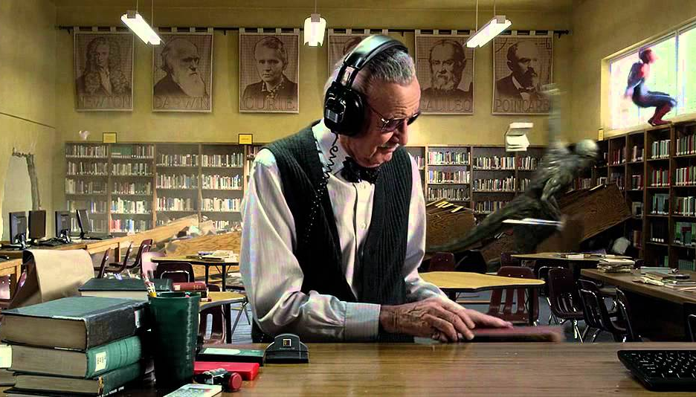
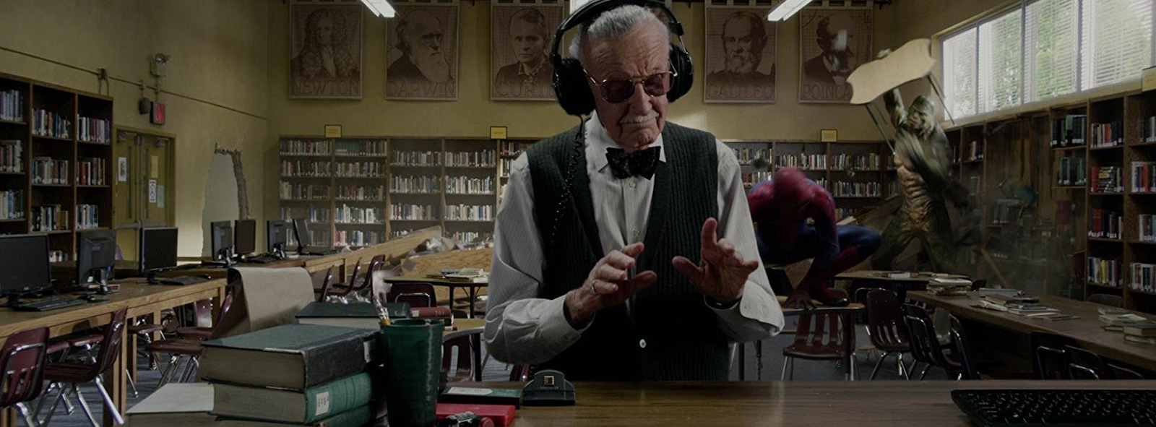
Notes:
The Amazing Spiderman - Funny Library Scene

Slide 9
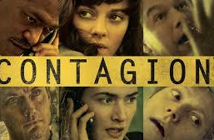
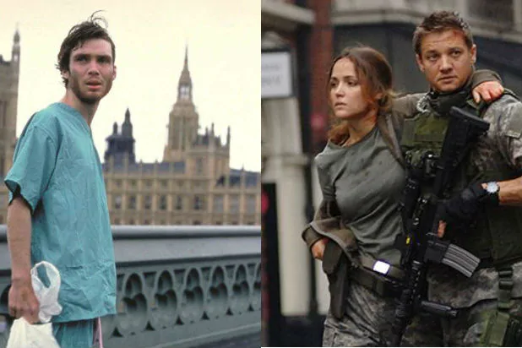

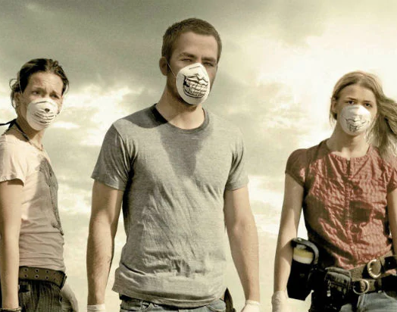
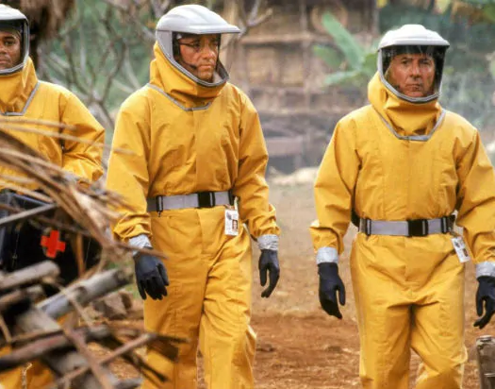

Slide 10
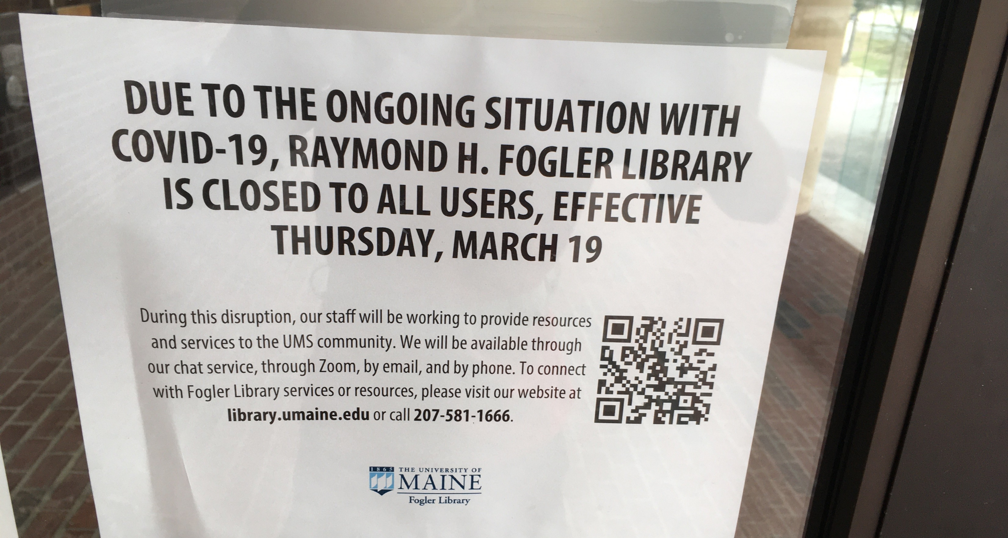
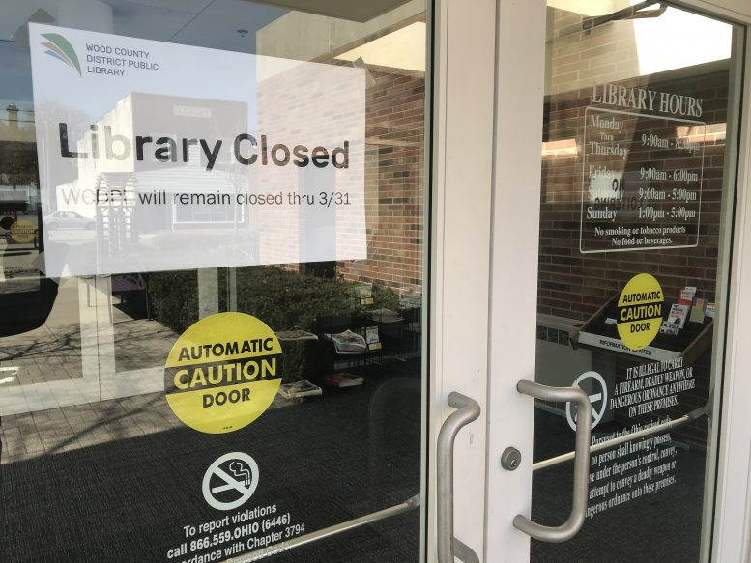

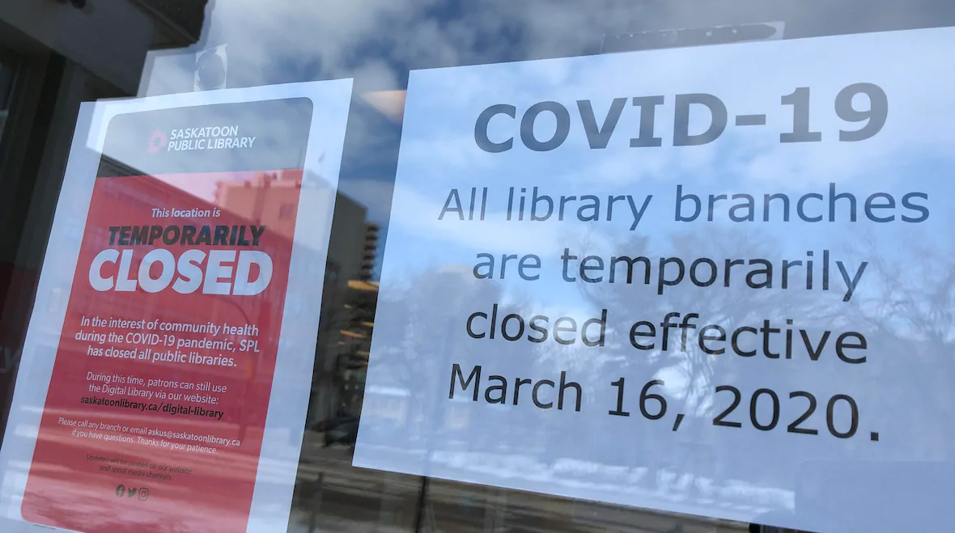

Slide 11
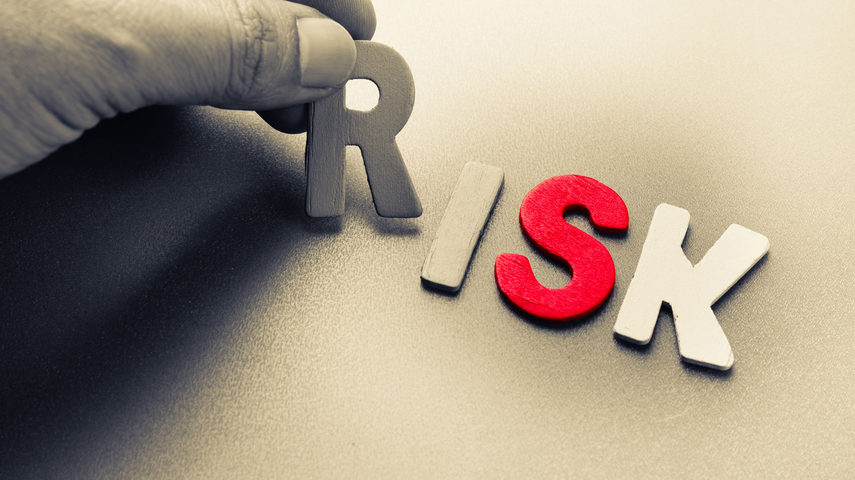
Categories and Types

Slide 12
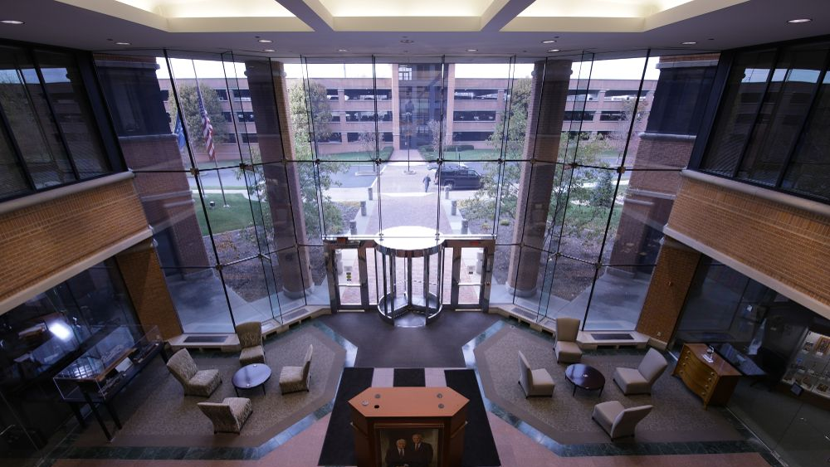
Risks Categories
Natural risks
Technological risks
Human-caused risks
Security risks
Proximity risks
Enterprise risks

Slide 13
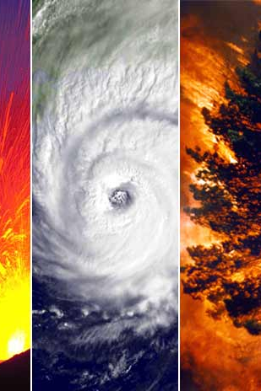
Natural risks
Flooding and water ingress. Any library site near a river, lake, harbour or other natural body of water is at risk from flooding. Water ingress – defined as seepage of water into a building – can also occur through an open window, a leaky roof.
Fire, smoke and fumes. Naturally occurring fires threaten any library situated near forests and other wooded areas. Any vegetation – including farmers’ crops, gardens in urban parks and tumbleweed. Smoke and fumes can pose a serious risk not only to employees but also to fragile IT equipment.
Severe weather. Any weather event that becomes extreme can be defined as severe. Winter storms, thunderstorms, high winds and heatwaves are common examples. Thunderstorms can involve lightning, which can cause fires.

Slide 14
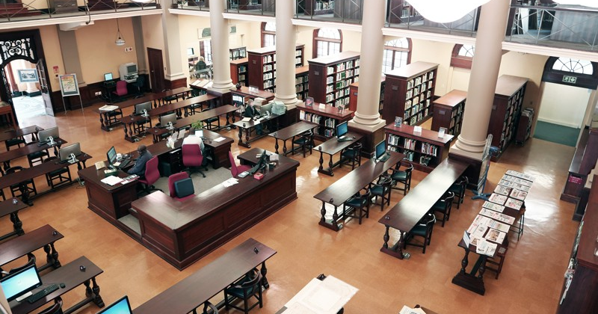
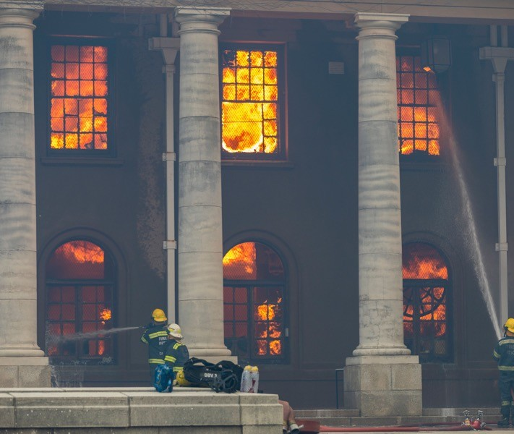
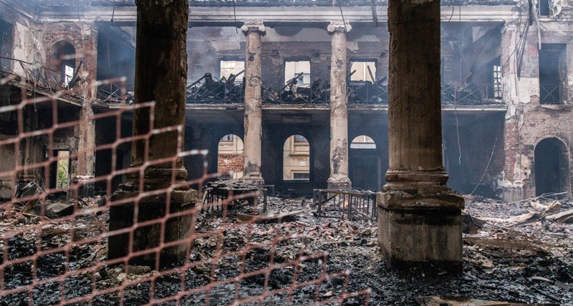
African Studies Library, The University of Cape Town (UCT)

Slide 15
According to a statement by UCT
The African Studies Collection was started in 1953.
The archival and published collections stored in the Reading Room were destroyed.
This includes most of the African Studies published print collections,
  About 70 000 items, the 3500 African Studies DVD’s,
  All the UCT university calendars,
  Government publications from South Africa and across the continent,
  Collection of manuscripts and archives that had been recently digitised or were about to be processed or digitised.

Slide 16
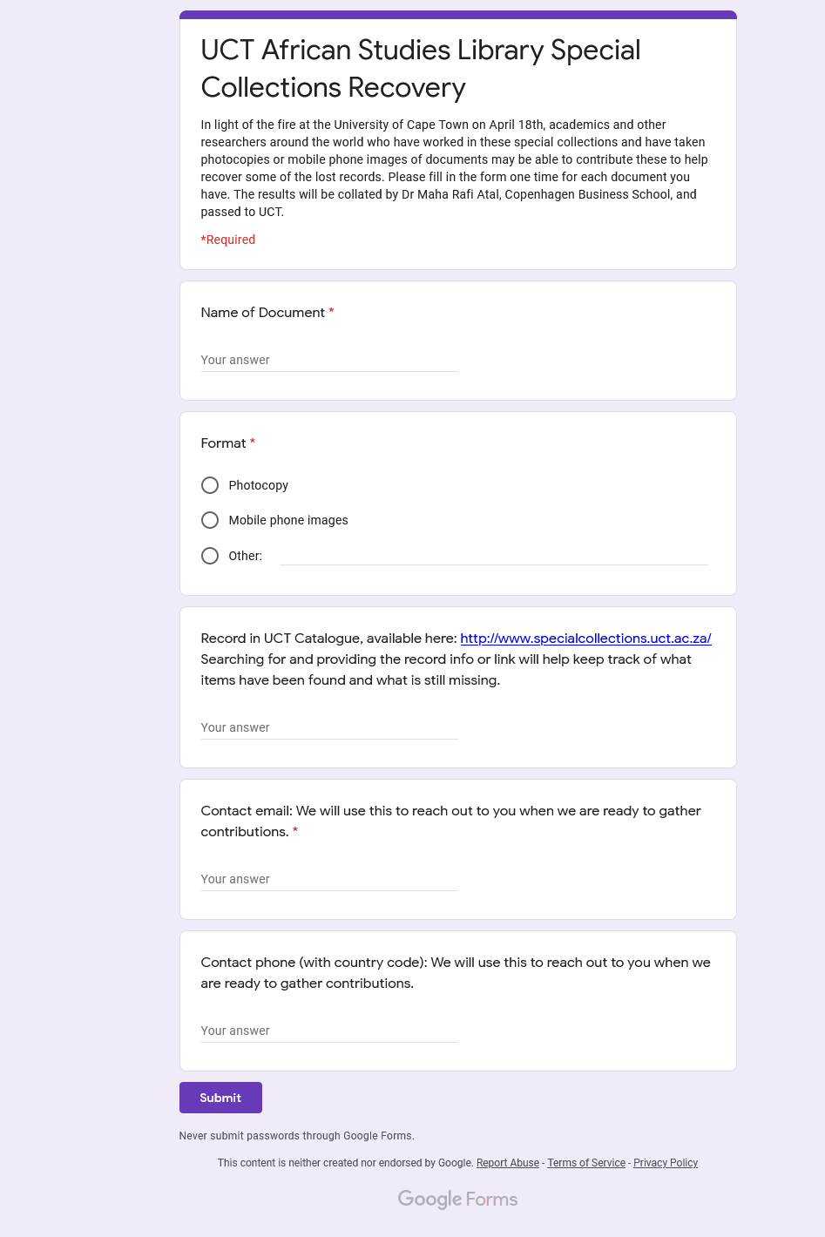
The University has issued a call for academics and researchers from around the world who have photocopies or images of documents of these special collections to contribute to recovering the materials lost in the fire.
Notes:
https://docs.google.com/forms/d/e/1FAIpQLSe5xp7JCEu8bFliwzIl3lBdESKqd5agb9Ngat-O-zsN1WQVOg/viewform

Slide 17
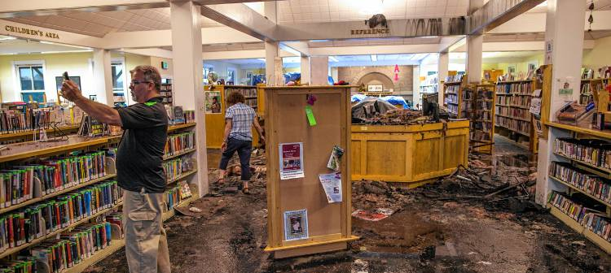
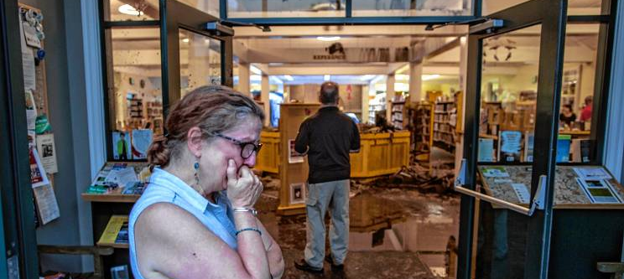
Lightning strike at Hopkinton Town Library
Notes:
the damage in the water-soaked main area of the Hopkinton Town Library on Friday after a lightning strike started a fire at the building (Published: 8/3/2018)

Slide 18
Natural risks (cont.)
Earthquakes. Library buildings and heavy furniture – including shelving systems – are particularly at risk from earthquakes.
Tsunamis. These earthquake-generated sea waves move at high speed and can destroy coastal cities and their outlying communities. Tsunamis can wipe out not only a region’s libraries, but its entire information infrastructure, including archives and records centres.
Landslides and avalanches. Such natural phenomena occur most often in mountainous regions, although any natural slope – for example, a hillside in an urban park or along a suburban road. These could cut off libraries and their communities from neighboring areas and disrupt schedules and routines.

Slide 19
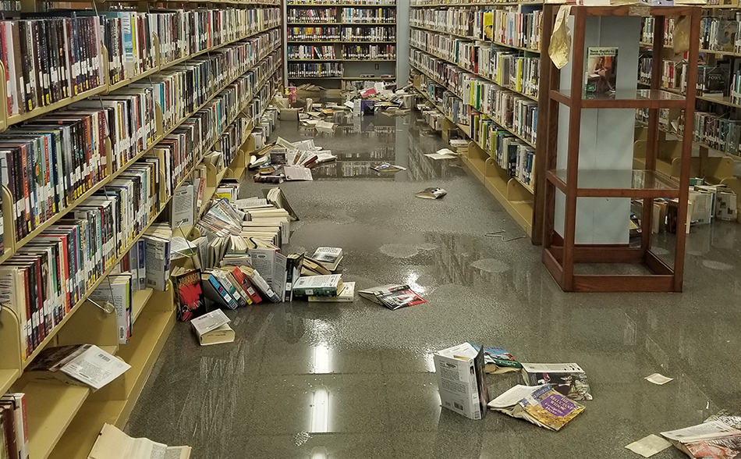
Hurricanes Harvey and Irma, Texas coast, 2017

Slide 20
Natural risks (cont.)
Pandemics. The last serious pandemic that caused high levels of fatalities was the Spanish Flu of 1918. High-traffic libraries could face lengthy closures in the event of a pandemic.
Volcanoes. Most often, volcanoes are in seismic zones. Volcanic explosions are often accompanied by earthquakes. Aside from damaging any community in their immediate area, volcanoes can also disrupt transportation and communications.
Drought. Absence of precipitation and the resulting lack of water for human use can occur not only in countries such as Somalia. Drought can result in crop failure, famine and the displacement of entire populations.

Slide 21

Technological risks
Power outages and brownouts. A sudden loss of power can result in darkened stack areas. They can lead to library closures and data loss. A related risk is a power spike or surge, during which electrical equipment could be overloaded and burned out.
IT failure. includes the malfunction of computer hardware and software, often resulting in unintended shutdown and data loss.
Data loss. While data loss can be the result of accidental deletion, power outages and spikes, and theft, it can also be due to a deterioration of the media: an aging media that has been stored in an inappropriate environment.
Telecommunications disruptions. modern organizations rely on a variety of technologies, a foundation of which is the telephone system. Most disruptions in telephone service are due to either overloading or line breakage.

Slide 22
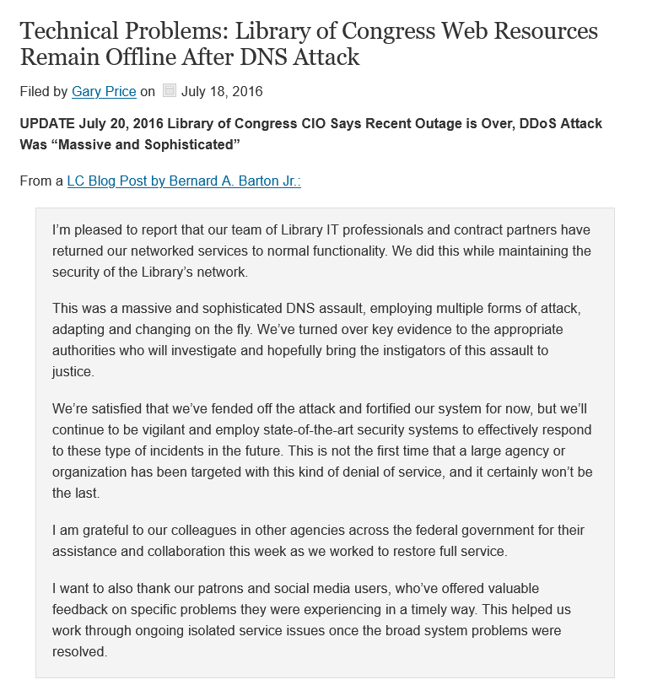
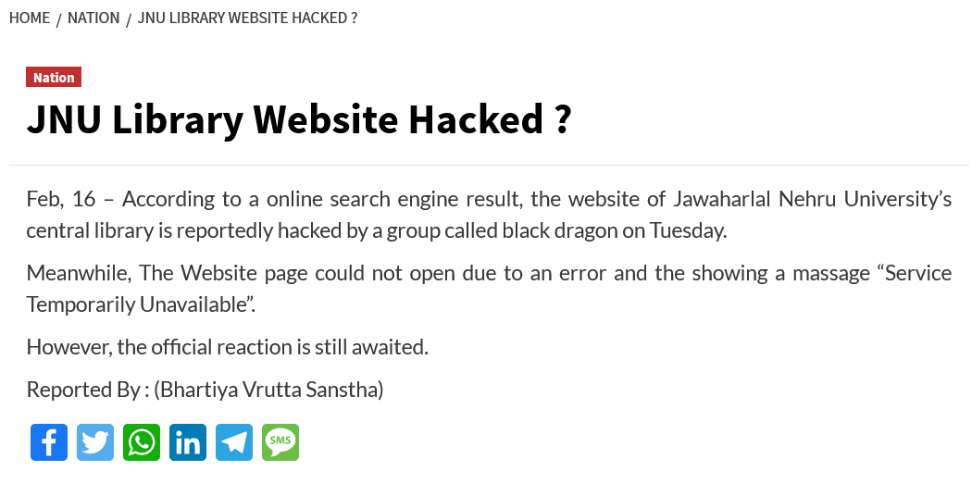

Slide 23
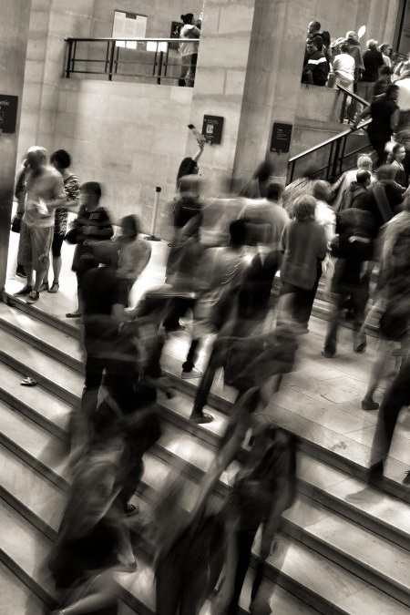
Human-caused risks
Potentially, the most destructive human-caused risk to libraries is war.
Civil unrest and rioting can be dangerous for libraries, but these are not often as destructive as war.
The most common human-caused threats are less dramatic, but in some cases they can cause extensive damage in libraries.
One of the biggest risks to any IT system is human carelessness. People delete enormous amounts of data accidentally.

Slide 24

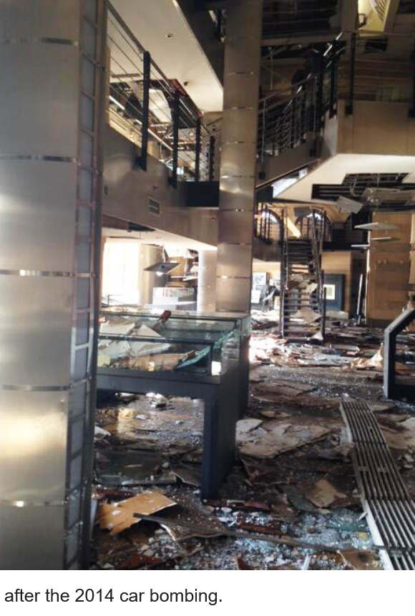

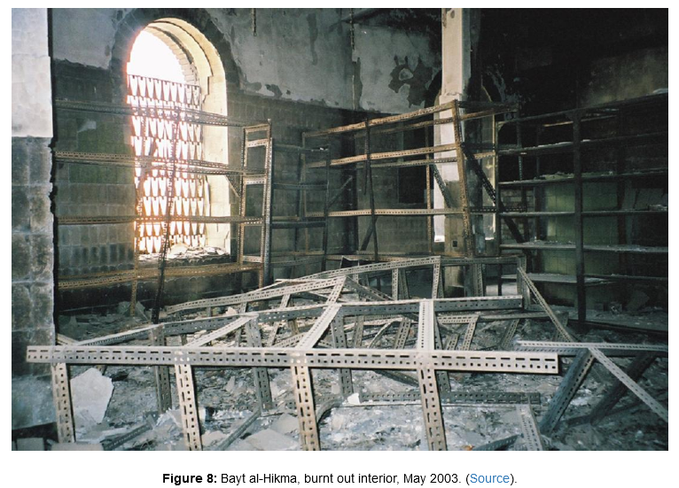

Slide 25
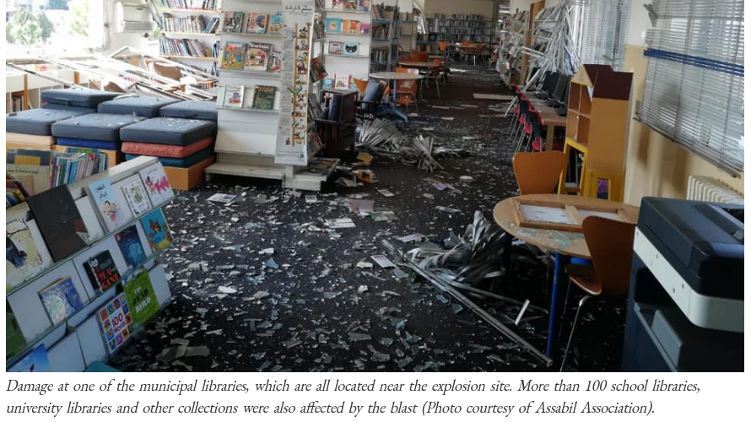

Slide 26
Human-caused risks (cont.)
Apathy: ‘I really don’t feel like reviewing this data back-up procedure. Boring! I’ll do it next week, maybe, if I find the time.’
Carelessness: ‘Whoops! I dropped that big old atlas that everyone makes a fuss about, and the binding broke. But I gathered up all of the loose pages, that is except for a few in the middle. I don’t know where they went. Sorry.’
Forgetfulness: ‘I forgot to lock the server room, and now we’re missing the server with all of the borrower data. Sorry.’
False assumptions: ‘I thought that the clericals would bring in those boxes from the loading bay, and they didn’t. Those old books that we acquired at the auction in New York got wet last night when it rained. They got really wet, but they should be fine when you dry them out. Shouldn’t they?’

Slide 27
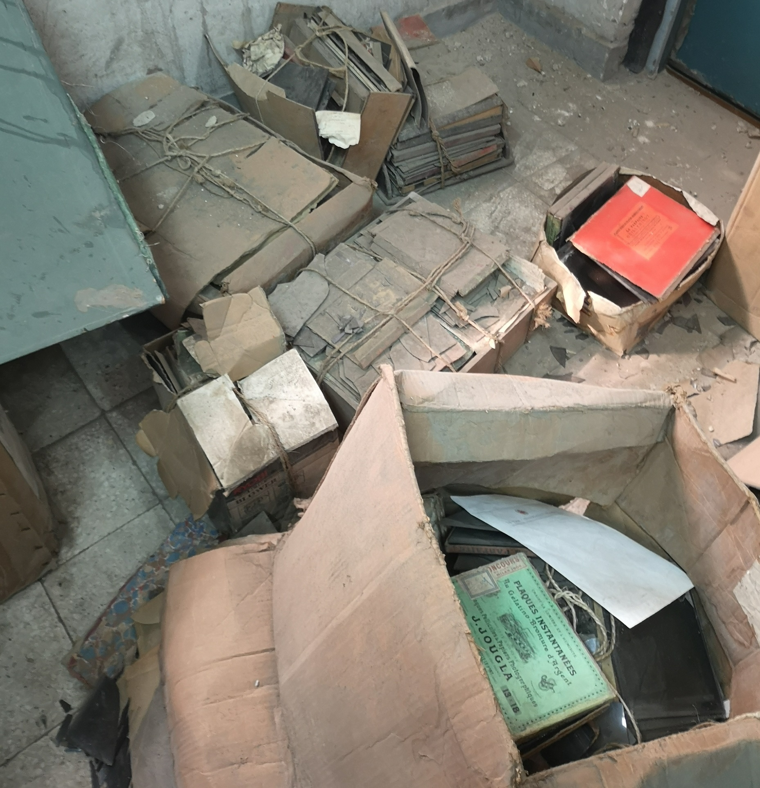
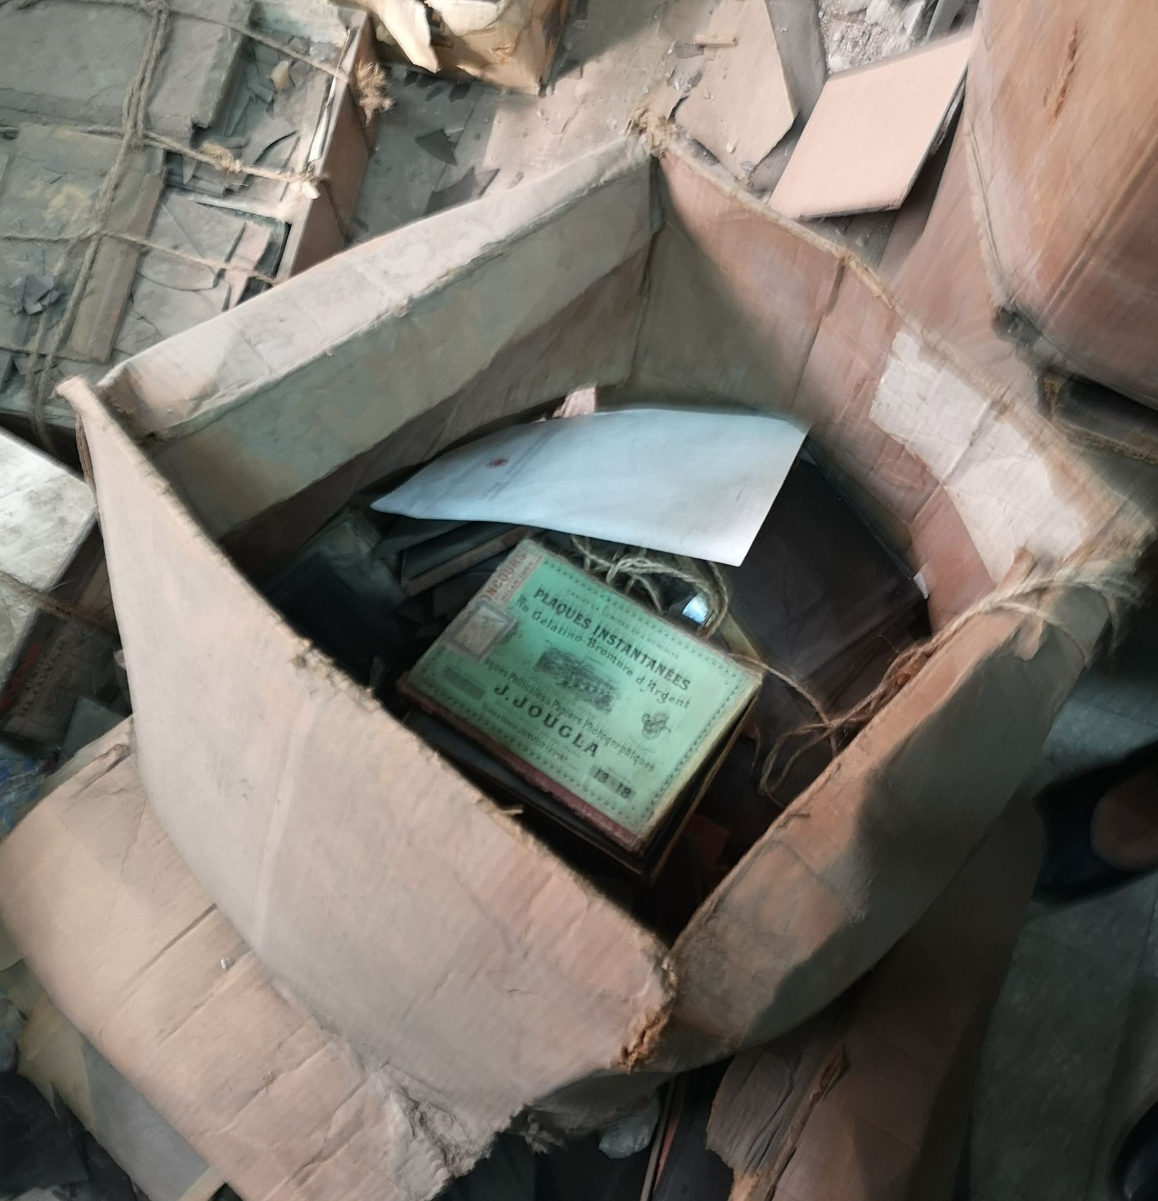

Slide 28
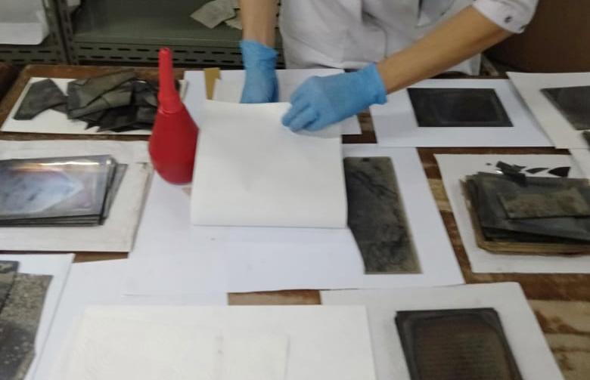
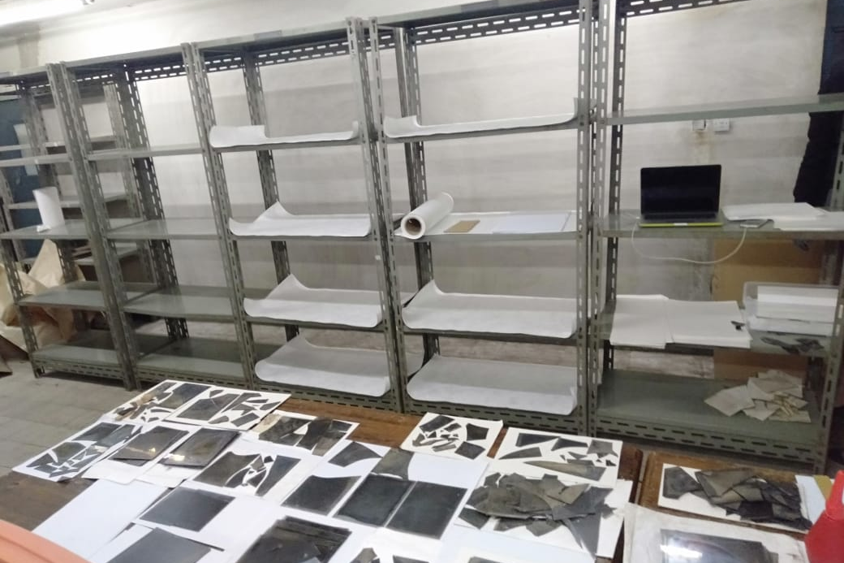
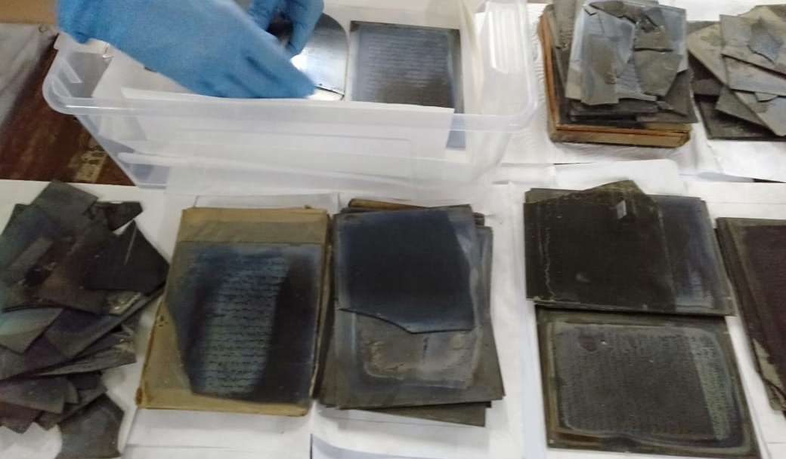
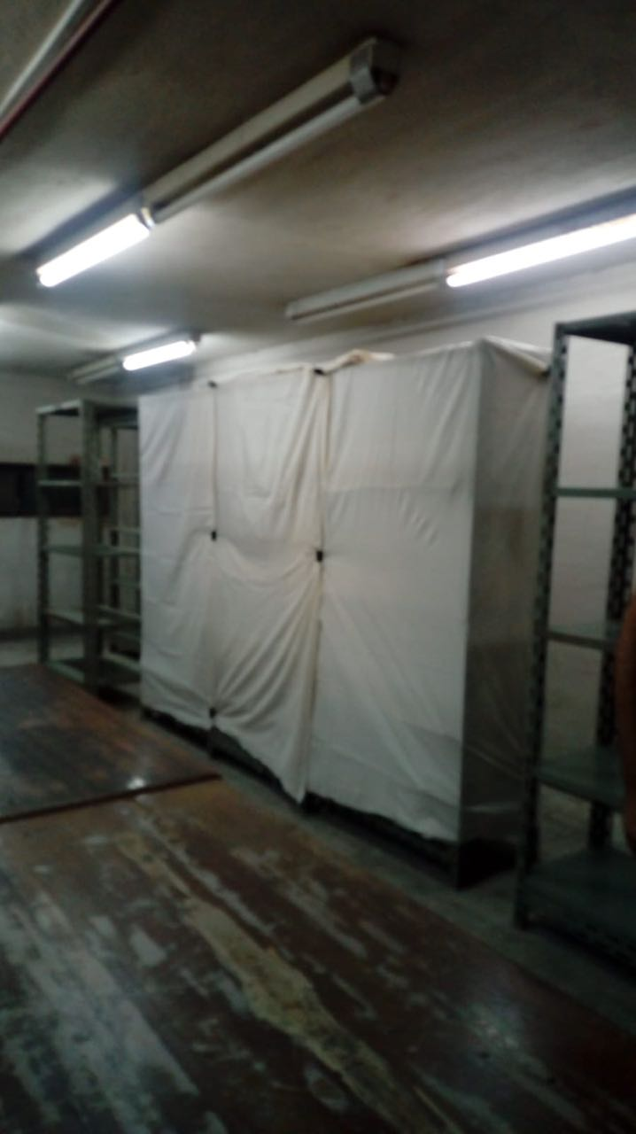
Notes:
مثال على اللامبالاة.. وعلى أهمية اتخاذ القرار

Slide 29
Human-caused risks (cont.)
Inattention to detail: ‘Did I back up all of today’s cataloguing data? Perhaps not. Well, if you lose any, that’s a pity.’
Ignorance of internal policies: ‘Is it okay to show patrons around the rare book vault? He was in there for quite a while. No, I haven’t had a chance to read the security manual, but I will, maybe next week.’
Inattention to laws and external regulations: ‘One of our older patrons had a heart attack in the reference area last week. Nobody on staff had the training of first aid. county’s occupational health and safety code demands that we have at least one fully trained first aid attendant on site during business hours.

Slide 30
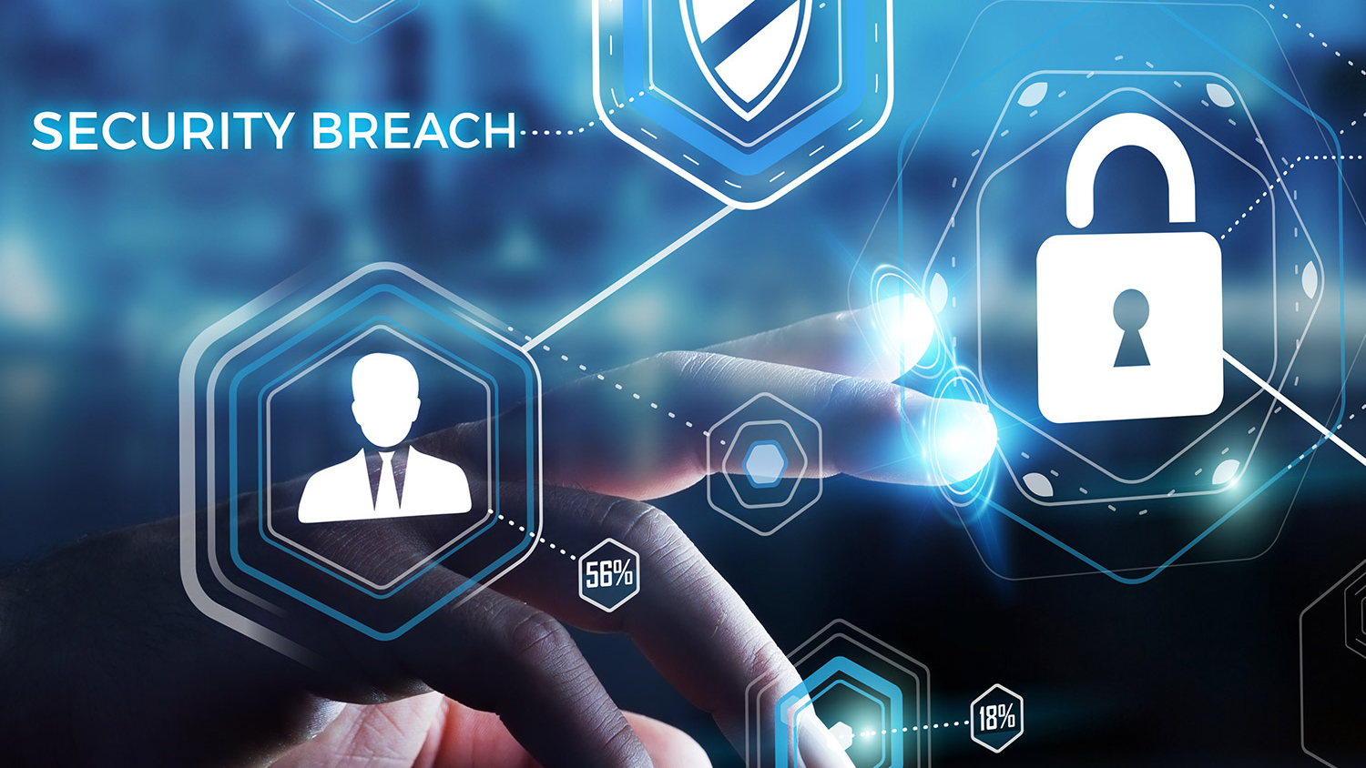
Security risks
Theft. Library assets most often stolen are:
  Printed materials of any sort, but particularly rare and valuable materials such as incunabula, early maps and atlases, and noteworthy editions of famous works; also rare ephemera such as concert posters
  Valuable reports, white papers and other grey literature.
  Manuscripts, including valuable correspondence, diaries, journals and hand-drawn maps.
  Sound recordings of any sort, but most often recordings by popular musicians, orchestras and bands.
  IT equipment, particularly that which is set up in public areas.

Slide 31
Security risks (cont.)
Fraud and information theft. Like most organizations, libraries could be defrauded by means of bogus documents, false ID, hacking and computer scams.
  Special and corporate libraries hold information that could be considered confidential, and potentially valuable to outside persons and organizations, particularly those in the media.
Sabotage. A disgruntled employee could sabotage library operations by erasing valuable data, causing a plumbing malfunction or planting a computer virus.
Arson. Usually the work of a lone miscreant. Arson is a proximity risk for many libraries in urban neighborhoods. In recent years, arson has become more common during riots and violent protests.

Slide 32
Security risks (cont.)
Workplace violence. This is defined as violence or the threat of violence by any one person in a workplace toward any other person.
Bomb threats. Organizations with a moderate to high public profile are targets for bomb threats. These threats are made by pranksters, disgruntled employees, and occasionally by hostile political activists.
Malware. Computer viruses, time bombs, Trojan horses, and worms are increasingly sophisticated and common. While many libraries use advanced electronic protection, there is always a risk of a malware attack.
Vandalism. Vandalism at library sites usually has a minimal effect on operations, unless vandals succeed in damaging power lines or computer equipment.

Slide 33
Proximity risks
Neighbouring buildings. Risks at sites and in buildings near a library might include:
  inadequate fire controls, inattention to the requirements of the Fire Code
  older plumbing and electrical circuitry
  substandard maintenance
  older structures unable to withstand earthquake loading
Gas (or petrol) stations and fuel tanks. Fuel spills, fires and explosions can occur on any site that contains fuel tanks. In many cases the cause of these problems is human error.

Slide 34

Assessing,
Planning, Preserving,
Training, etc.

Slide 35
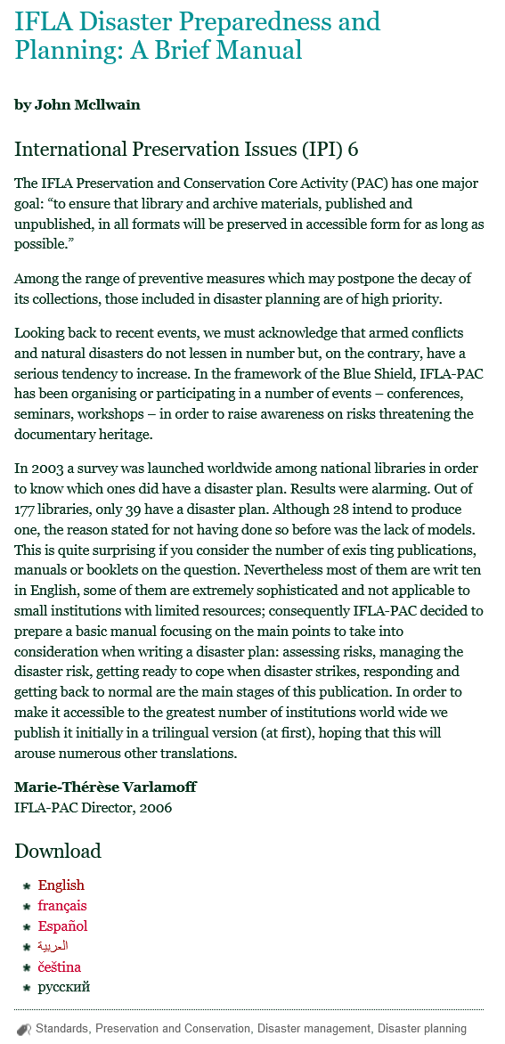

Disaster Plan
In 2003 a survey was launched worldwide among national libraries in order to know which ones did have a disaster plan. Results were alarming:
  Out of 177 libraries, only 39 have a disaster plan.
  28 intend to produce one
  the reasons stated for not having one were the lack of models, most of them are writ­ten in English, some of them are sophisticated and not applicable to small institutions with limited resources.
IFLA-PAC published a basic manual focusing on the main points to take into consideration when writing a disaster plan:
  assessing risks, managing the disaster risk, getting ready to cope when disaster strikes, responding and getting back to normal.

Slide 36

Disaster Preparedness
Libraries and archives need to prepare themselves for possible disasters.
Analyzing their own situation and resources and devising a disaster preparedness plan.
The basic concept of a disaster preparedness plan is to:
  minimize risks so far as possible
  maximize the efficiency of response if a disaster occurs
To produce an effective plan an institution needs:
  careful assessment of the major dangers that might befall it, and of their relative like­lihood
  realistic awareness of the existing resources (budget, staff, etc.) and procedures to cope with a disaster.
  commitment to continual promotion and implementation of the recommendations of the plan in the years to come.
No single plan suits all

Slide 37
Risk management
Identifying The Sources Of Potential Disaster
The process of measuring or assessing risk and then developing strategies to manage the risk.
The identification, analysis, assessment, control, and avoidance, minimization, or elimination of unacceptable risks.
Risk Analysis is the procedure of addressing and qualitatively and quantitatively interpreting all risks that may potentially arise.
The ability to plan is dependent upon having staff with expertise in disaster planning and risk management.

Slide 38
Grading scale used in assessing risk
Impact
Catastrophic | Organization would not likely survive in present form Sustained, serious loss in user share Loss of library value where the cost of future library investment outweighs the recovery
Major | Major impact on library—serious damage to library’s ability to service users Serious diminution in library value and use with adverse publicity
Moderate | Significant impact on library—would affect users Use and/or library value will be affected in the short term
Minor | Impact on internal organization only There is a minor potential impact on use and library values
Insignificant | Insignificant impact on internal organization No potential impact on use No impact on library value
Likelihood
Almost certain | Event is expected to occur in most circumstances
Likely | Event will probably occur in most circumstances
Possible | Event might occur at some time—moderate probability
Unlikely | Event could occur at some time—low probability
Rare | Event may occur only in exceptional circumstances

Slide 40
4Ts Strategy
Transferring risk: assigning an individual, group or third party to be responsible for the risk
Treating risk: controlling risk through actions that reduce the likelihood of the risk occurring or minimize its impact prior to its occurrence
Terminating risk: - altering processes or practices to eliminate risk completely
Tolerating risk: no action is taken to mitigate or reduce a risk (it still needs to be monitored)

Slide 41

Digital Preservation

Slide 42
Digital Preservation Planning
Consider offsite server space or cloud storage
Backup files
Digitization
Work with your institution’s IT department
Include in disaster plan

Slide 43
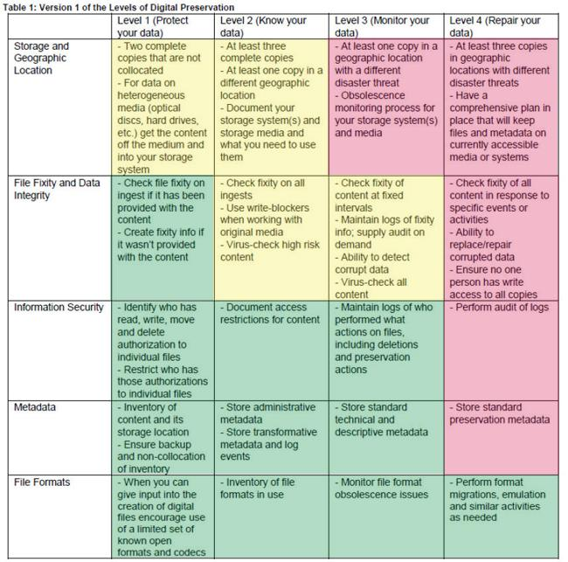
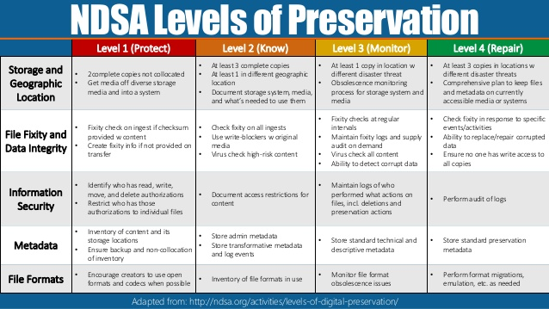
Notes:
The stewardship maturity matrix for digital environmental data products (Documentation ID: NCDC-CICS-SMM-0001; Version: 12/09/2014 Rev. 1)
National Digital Stewardship Alliance

Slide 44
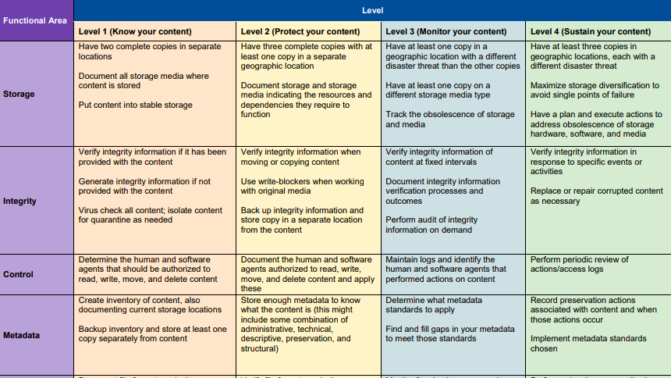
Notes:
The Levels of Digital Preservation (LoP) is a resource for digital preservation practitioners when building or evaluating their digital preservation program. Originally created in 2013, Version 2.0 was released in 2018 along with additional supporting documentation and resources.

Slide 45
You Should Know…
Risks can never be completely removed; much can be done to mitigate their effects.
Risk assessment is a snapshot amid continual changes in the challenges faced by libraries, such as new technology, regulatory requirements, organizational restructuring, new leadership personnel, etc.
It is also important to acknowledge that in libraries, as in all industries, a risk and challenge may be the shadow of an opportunity.
Libraries and other information management organizations are not likely to have a comprehensive risk management or disaster plan, unless they have been through a disaster before, or if they are in a high-risk environment.
Notes:
Muir and Shenton (2002)

Slide 46
You Should Know…
There is no easy way out of risk management.
Don't expect perfection. There will be things that occur that you failed to predict. It's how you react to those unpredictable events that matters.
Lack of information for decision-making leaves management with little insight as to what is really happening or is likely to happen.
Risk Management is complicated, so don’t be afraid to see what others have done. There are great frameworks and tools available to address risk.
The level of risk we face is continually changing, with new risks emerging and others becoming less critical. By being proactive and regularly monitoring your exposure, you will be ready to act when the time comes.

Slide 47
You Should Know…
Get to Know Your First Responders!
  Invite the fire department, law enforcement to tour your library
  Point out the locations of your most important collections
  Make the tour engaging! They will be more likely to remember you during time of disaster if they had a memorable experience

Slide 48

RECOVERY
GETTING BACK TO NORMAL

Slide 49
Business continuity planning
Documents include disaster plans and the information needed to rebuild or recover from any type of disaster.
Plan 'designed to avoid or mitigate risks; to reduce the impact of the crisis; and to reduce the time to restore conditions to a state of “business as usual".
According to the Business Continuity Management Policy (2014) of the New South Wales Library Council the priorities of the policy are:
  Safety and welfare of people
  Preservation of collections
  Continuity of services
  Reputation and compliance.

Slide 50
WHAT SHOULD WE DO..?

Slide 51
Do's and Don'ts
A true disaster plan should assume the worst-case scenario of widespread damage and loss. This includes the loss of water, communications, infrastructure, as well as access to the library, staff and resources.
By identifying, assessing, and setting foundations for responding to threats, your library will be better able to avoid—or at least minimize harm—from things like data breaches, cybersecurity flaws, and more.
Don't expect perfection. There will be things that occur that you failed to predict. It's how you react to those unpredictable events that matters.
Doesn’t matter how well you prepare yourself on your own site, You must look at what’s next door. For your own safety and your library’s, have a look around.’

Slide 52
Do's and Don'ts
The practice of risk management helps prepare organizations to handle harmful situations before they arise.
You must guard against secondary risks, which can cause more damage than the risks that give rise to them. All-natural risks have secondary risks.
Don't ignore the obvious, the warning signs posted and resists bad news or facts.
You should never take the probability and impact assessment of risks lightly.
Do involve everyone; Risk management works best when everyone is empowered to speak out and take action.

Slide 53
Do's and Don'ts
Not all risks within processes or functions within a library should be treated the same way. An impact analysis allows libraries to identify which parts are most critical to its operations.
Document all risks in a risk register along with who is responsible for what and appoint a risk.
Do assign responsibility for taking corrective actions by an agreed-upon date. If budget and/or time are limited, implement corrective actions in stages.
Training your staff on what constitutes risk so they know what to look out for and how they can contribute towards risk management.

Slide 54
References
Robertson G. (2015). Libraries and risk. Disaster Planning for Libraries, 1–9. https://doi.org/10.1016/B978-1-84334-730-9.00001-6 , https://www.ncbi.nlm.nih.gov/pmc/articles/PMC7151802/?report=classic
John McIlwaine (2006). IFLA Disaster Preparedness and Planning: A Brief Manual. https://www.ifla.org/publications/node/8068
Velasquez, D. L., Evans, N., & Kaeding, J. (2016). Risk management and disaster recovery in public libraries in South Australia: a pilot study. Information Research: An International Electronic Journal, 21(4), n4. http://informationr.net/ir/21-4/paper735.html
Michalowicz, Mike (2018). Risk Management Planning: 4 Dos and Don'ts to Consider. https://www.americanexpress.com/en-us/business/trends-and-insights/articles/risk-management-planning-4-dos-and-donts-to-consider/

Slide 55
References
Wylie, David (2020).The Do's and Don'ts of Managing Risk in the New Year. https://www.tasbrmf.org/learning-news/insiderm/home/safety-security/the-do-s-and-don-ts-of-managing-risk-in-the-new-year.aspx
Amy Zimmer, Kate Tallman, Samantha Hager. When Disaster Strikes: Will Your Library Be Ready?, Western States government information virtual conference. (pdf file)
العمري ، أديب ؛ إبراهيم الخلوف الملكاوي (2007) ، دور إدارة المعرفة في التقليل من آثار المخاطر ، المؤتمر العلمي الدولي السابع، جامعة الزيتونة الأردنية الأردن.
المطيري، سعد نافع (2017). دور ممارسات إدارة المعرفة في فعالية إدارة الأزمات: دراسة لاتجاهات موظفي الشركة السعودية للكهرباء. أطروحة دكتوراه، قسم علم المعلومات، جامعة الملك عبد العزيز، السعودية.

Slide 56


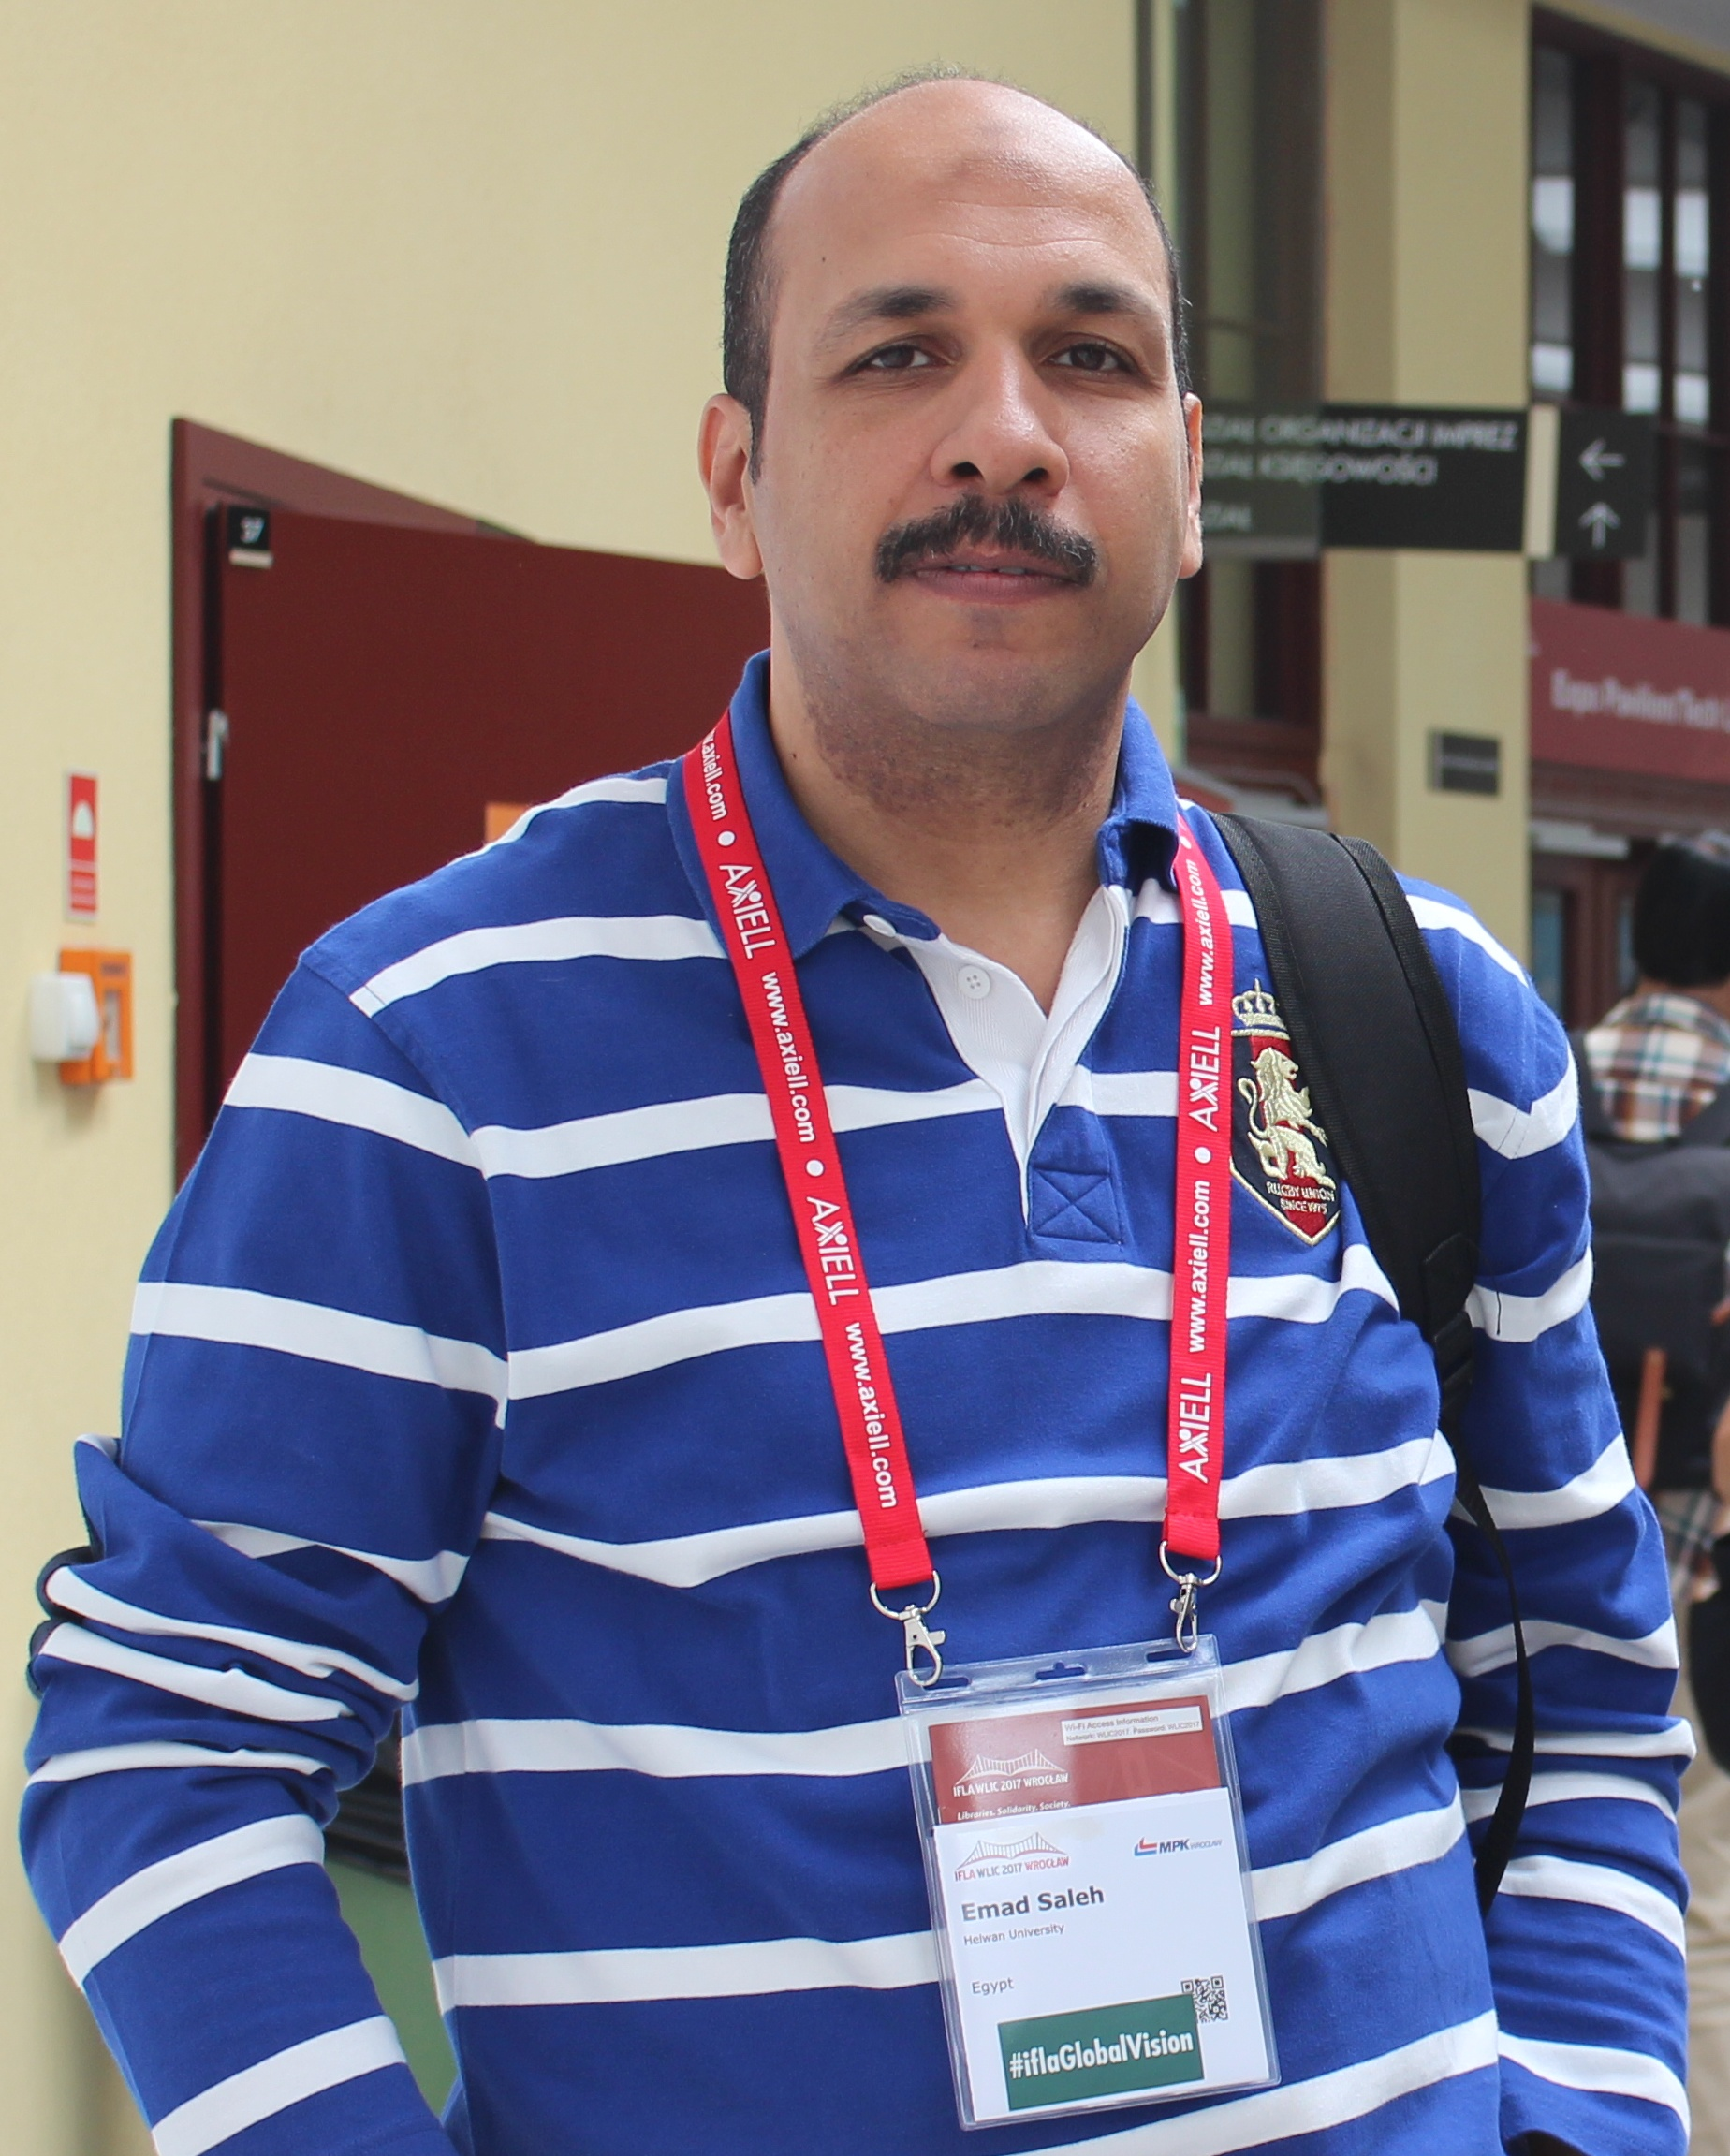



Prof. Emad Eisa Saleh
Professor of Information Science, Helwan University, Egypt
Vice president of Arab Federation for Libraries & Information
Former Director of Dar El-Kotob (Egyptian National Library)
emad.saleh2@gmail.com
/emad.saleh.186
/DrEmadSaleh
@ DrEmadSaleh

