Slide 1
Queensland Parliamentary Service
Delivering a curated media alerting service to the clients of the Parliamentary Library

Slide 2
Queensland Parliamentary Library
The Parliament
Our Clients
What we do
Authoritative
Impartial
Timely
Notes:
The Parliament
- Unicarmel
Committee System
93 Members
Our Clients
Members
Committees
Electorate Offices
Ministerial and Opposition Staff
Parliamentary Staff
What we do
IMS and Research Service
Support clients by collecting news, AV, journals, articles, reports and other material relevant to our clients and current affairs in Qld
Index this material using keywords from our thesaurus, authorities and regions
Information is used as the basis for our alerting service
Recently changed Library Management System to Softlink and they have built an alerting service into the product to suit our needs

Slide 3
Why an Alerting Service?
Assists time-poor clients
Delivers specially curated content
Familiarises and connects clients with library services
Deliver information to clients remotely
Notes:
Our clients are time-poor and this enables them by pushing the information to them rather than forcing them to search for it
The content is selected and indexed by librarians with specialist knowledge and understanding of our clients interests, therefore they are getting more relevant information sent to them than they would from a google alert
When the client clicks on a link in the alert, it takes them too our catalogue which ultimately familiarises them with the library
When we contact clients about the alerting service, it enables us to connect with them about other services
Enables us to reach clients remotely when they are all over the state. This was particularly helpful during lockdown and we did notice a jump in usage during this time

Slide 4
Daily Alerts
Automated and sent twice daily
Daily News alert
Parliament Alert
Notes:
Alerts are automatically sent out
They are sent out at 9.30am in the morning and 3 pm
Time stamped so the same news doesn’t go out twice
Daily News Alert
Shows all the news we have collected from a core set of newspapers, television and radio programs
Divided up by newspaper title
Parliament Alert
- Specially curated alert that includes stories on Parliament administration and procedures from Queensland, Australia and the world

Slide 5
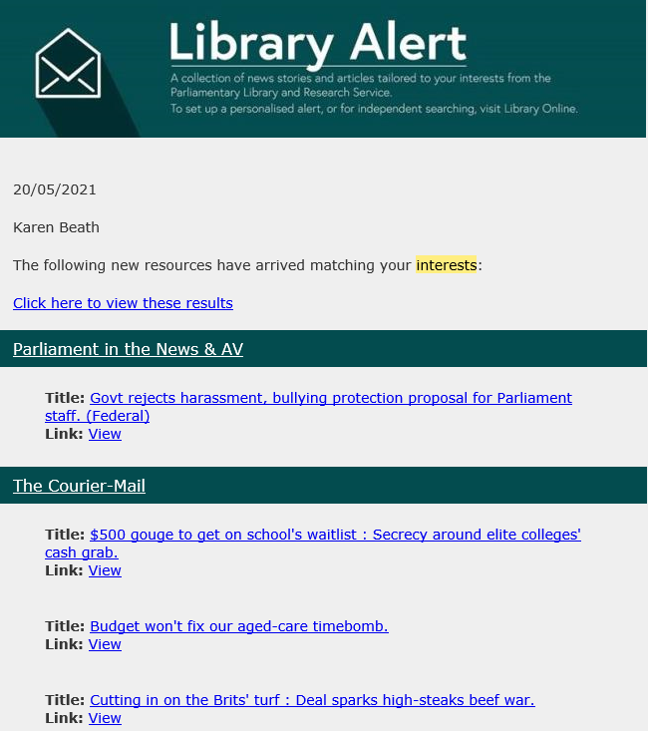
Sample Daily Alert

Slide 6
Weekly Alerts
Created on request
Customised to individual client needs
Created using “canned” queries
Sent on weekends
What’s New Alert
Manually Curated Alerts
Temporary Alerts
Notes:
Clients either contact us asking for an alert
We are regularly contact clients to find out if they would like any new alerts
- Alerts are based on topics of interest to the clients such as portfolio or committee area, electorates
Created based on a range of search terms such as full text, subjects, authorities or regions.
Using the system built by Softlink, a canned query is easily created
Alerts are currently sent on weekend’s
Also have a ‘What’s New’ alert which highlights new materials in the library that may be particular interest to clients
Some topics are so specific that they require us to add a particular tag to them, so that they are sent out in the alerts
We also created temporary alerts based on bills or inquiries a committee is looking at

Slide 7
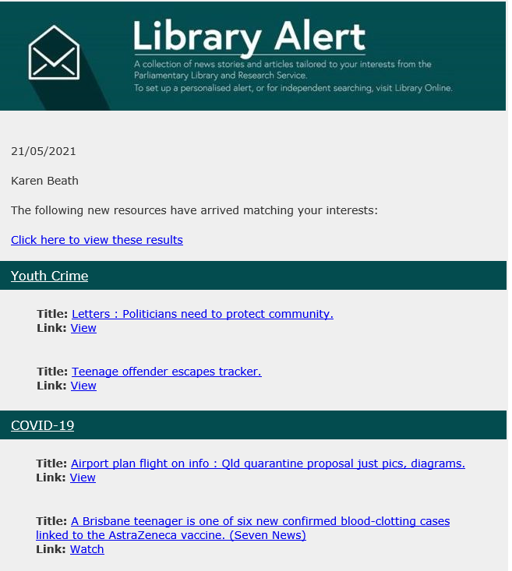
Sample Weekly Alert

Slide 8
Future Updates
More Daily Alert Services
Curate alerts that clients can subscribe to
Notes:
Would like to have more the specialised alerts running daily
We’d like to curate certain alerts on “hot topics” or popular journals that clients can subscribe to, in addition to requesting private alerts

